Slide 1
Preliminary results of the use of MUMmer and SeqKit, and statistics of rice chromosome 1
Mauricio Peñuela
August 2020

Slide 2
Install the seqkit program, you can do it using anaconda
conda install -c bioconda seqkit
To split fastq files into several files according with the ids, example “chromosomes”, use the command
seqkit split -i <file.fastq>

Slide 3
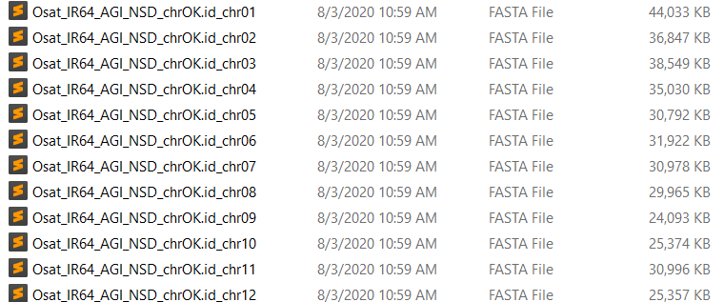
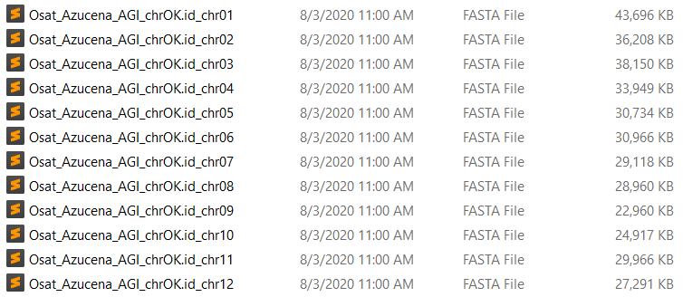

Slide 4
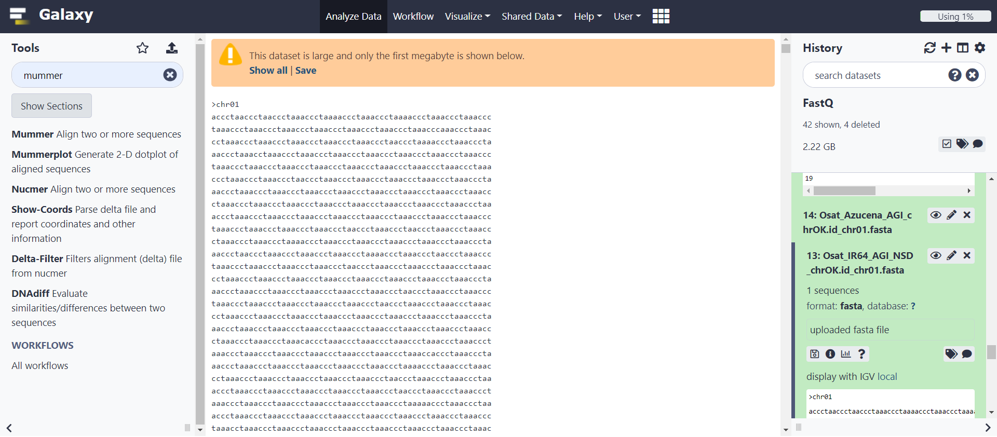
Use MUMmer 4 in Galaxy plataform: usegalaxy.org

Slide 5
Align with Nucmer using IR4 Chr01 as reference and Azucena Chr01 as a query sequences with default options, select yes in “Email notification” to receipt an email when the job is complete. This will produce an aligned file that can be visualized using Mummerplot

Slide 6
As you see, this data needs to be filtered. For this, we going to use the “Delta-Filter” tool

Slide 7
In the Delta-Filter tool select the aligned file and in the “Alignment Strategy” select the option: 1-to-1 global alignment not allowing rearrangements (-g). This option requires the alignments to be mutually consistent in their order, while the other options are not required to be mutually consistent and therefore tolerate translocations, inversions, etc.

Slide 8
Use the “Mummerplot” tool to charge the filtered-aligned file and enjoy the visualization of your data.

Slide 9
Now, use the “Show-Coords” tool to extract the coordinates of your filtered file.

Slide 10
Voilà! the coordinates are ready. Remember, you can visualize your output files with the eye icon. Download these files using the diskette icon and use them to continue your hard work.

Slide 11
To obtain the GC content of your fasta files use:
seqkit fx2tab --name --only-id --gc *.fasta

Slide 12
To obtain the bases content use:
seqkit fx2tab -H -n -i -B a -B c -B g -B t -B ac *.fasta

Slide 13
To obtain statistics from fasta files:
seqkit stat <file.fasta>
To locate motifs, first create a fasta file with the motifs, and then run the command:
seqkit locate --ignore-case --degenerate \ --pattern-file <motifs.fa> <file.fasta> -o <newfile.tsv>

Slide 14
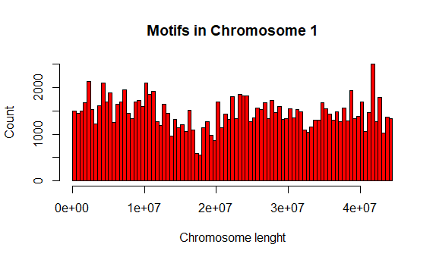
Breaks = 100

Slide 15
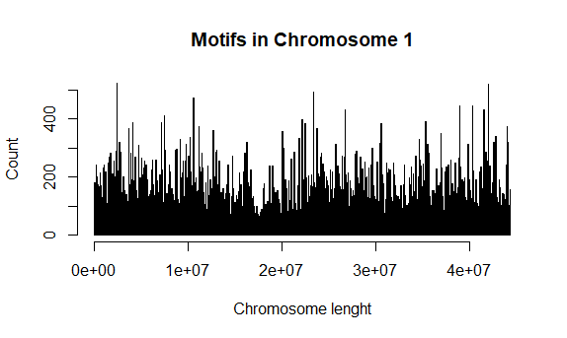
Breaks = 1000

Slide 16
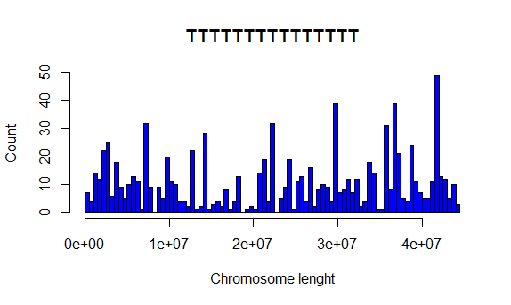
Breaks = 100

Slide 17
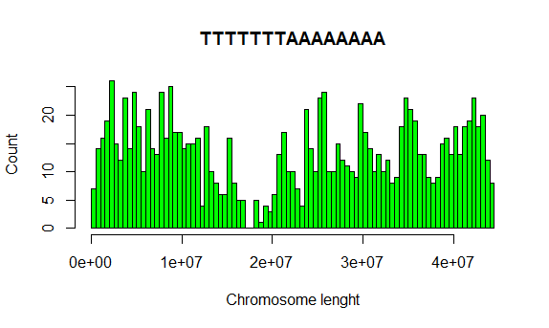
Breaks = 100

Slide 18
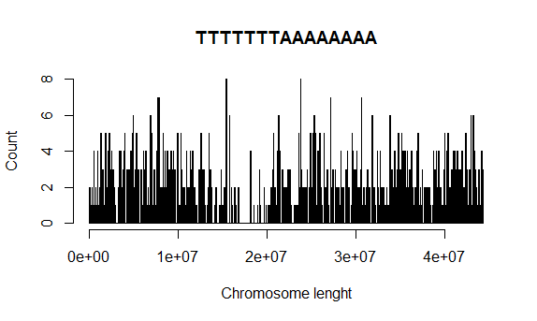
Breaks = 1000

Slide 19
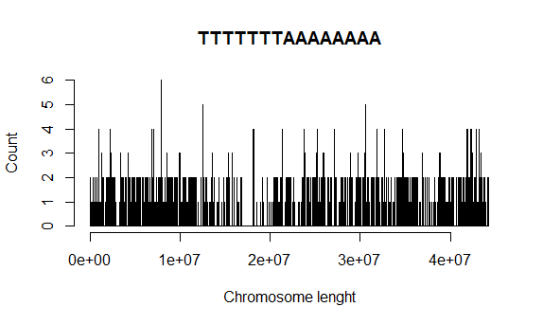
Breaks = 10000

Slide 21
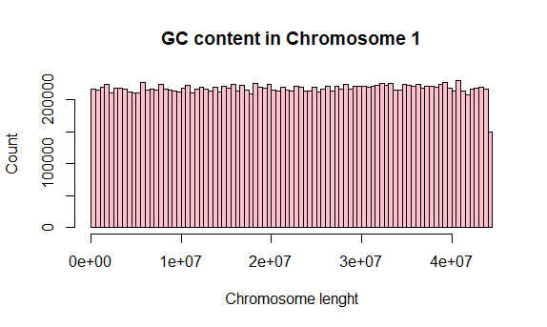
Breaks = 100

Slide 22
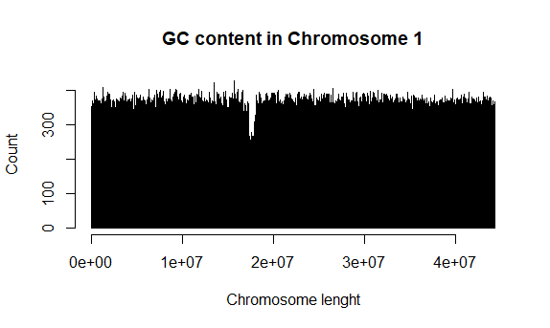
Breaks = 10000

Slide 23
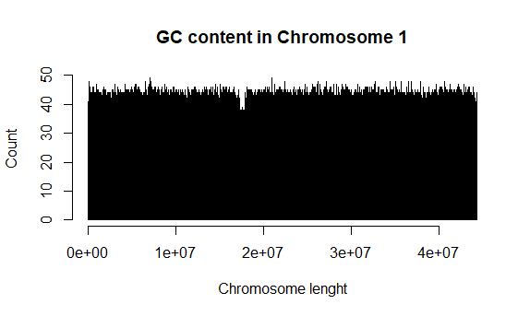
Breaks = 1000000

Slide 24
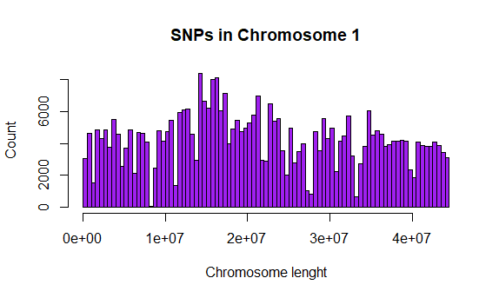
Breaks = 100

Slide 25
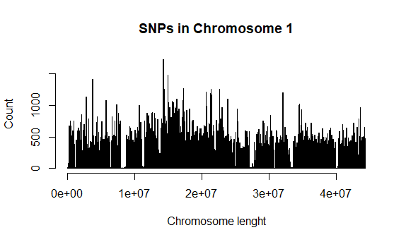
Breaks = 1000

Slide 26
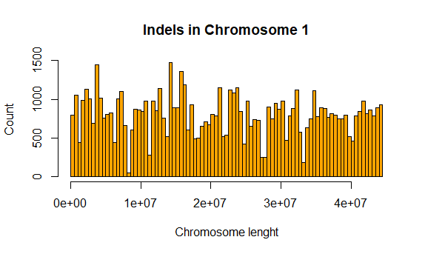
Breaks = 100

Slide 27
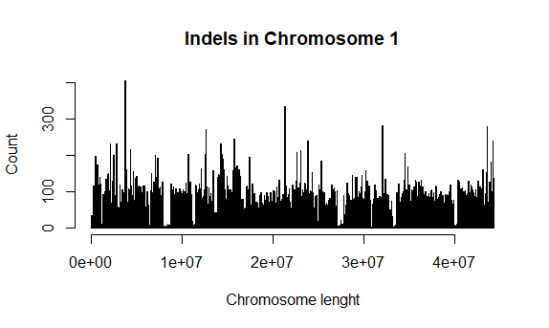
Breaks = 1000

